Slide 1







EVALUATING CHUNKING STRATEGIES FOR RAG
1
Chipo Sekabanja
CIS 530

Slide 2
TABLE OF CONTENTS
Slide 2 : Why Chunking Matters
Slide 3 : Three Pipelines Overview
Slide 4 : Dataset (EDGAR-CORPUS)
Slide 5 : Background & Related Work
Slide 6 : Semantic Chunking Results
Slide 7 : Semantic Chunking Process
Slide 8 : Alternative Pipeline (Diagram)
Slide 9 : Alternative Pipeline (Detail)
Slide 10 : RAGAS Results
Slide 11 : Results by Tier
Slide 12 : Benchmark Statistics
Slide 13 : Failure Analysis
Slide 14 : Precision vs Latency
Slide 15 : Challenges Encountered
Slide 16 : Key Findings
Slide 17 : Next Steps
2

Slide 3
WHY CHUNKING MATTERS
Fixed-size chunking ignores document structure. SEC 10K filings have 20 legally defined sections. Splitting mid-sentence destroys retrieval quality.
LLMs hallucinate when they don't know something. RAG fixes this by retrieving relevant passages first.
3

Slide 4
PIPELINES
Fixed-size baseline,
512 tokens, 50 overlap
4,877 chunks
Semantic baseline
MiniLM topic splits
3,700 chunks
Alternative pipeline
Reranking + filtering
Cross-encoder + detector
3
4

Slide 5
UNDERSTANDING THE DATASET
EDGAR-CORPUS · 10 filings · 8 industries
Arcimoto (EVs)
· Heritage Financial (banking)
· Oak Valley Bancorp (banking)
· MJ Holdings (cannabis)
· Biopharmaceutical (pharma)
· Joway Health (China/PRC)
· Self-administered REIT
· Smaller reporting co. (exempt)
4
5

Slide 6
BACKGROUND & RELATED WORK
Lewis et al. (2020) — RAG Framework
Introduced dense retrieval + seq2seq generation. Grounding LLM outputs in retrieved documents reduces hallucination on knowledge-intensive tasks.
Es et al. (2023) — RAGAS Evaluation
Reference-free RAG evaluation: Faithfulness, Answer Relevancy, Context Precision, Context Recall. LLM-as-judge scoring without human annotation.
Loukas et al. (2021) — EDGAR-CORPUS
6,500+ SEC 10-K filings pre-split into 20 structured sections. Financial NLP requires domain-specific preprocessing due to heterogeneous structure and dense numerical content.
This project differs: systematic retrieval failure classification + controlled chunking comparison on a domain-specific financial benchmark.
5
6

Slide 7
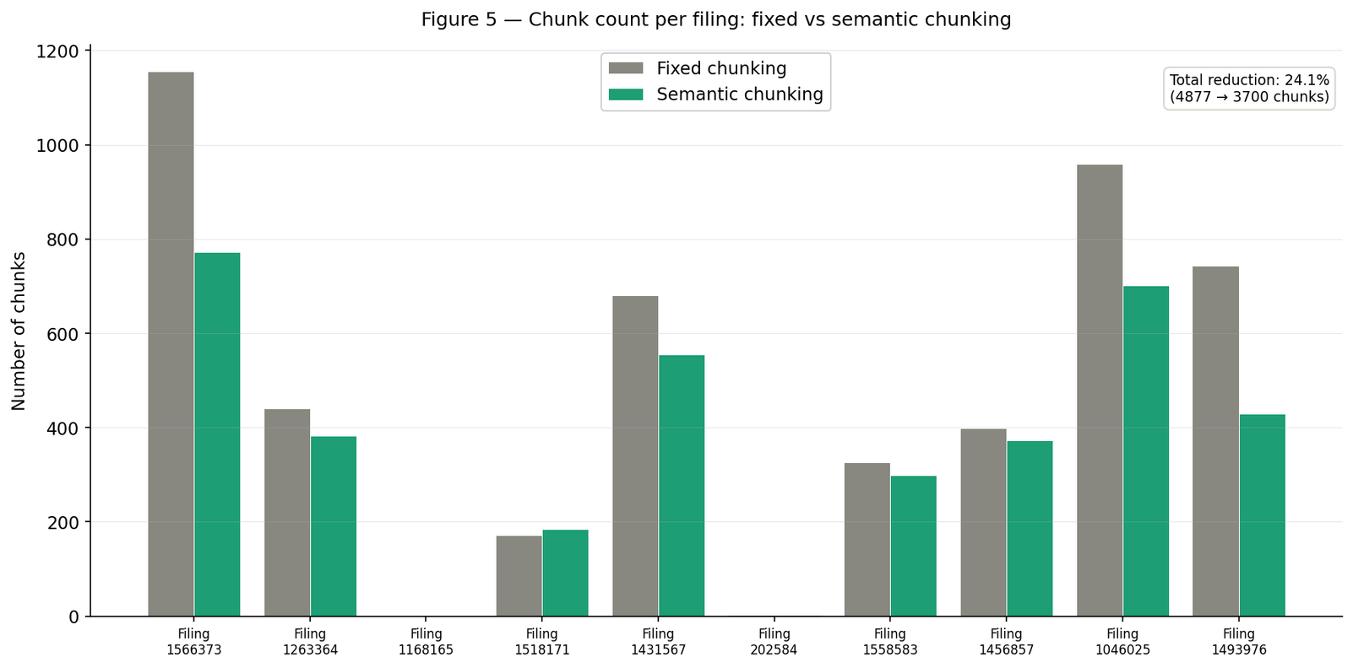
SEMANTIC CHUNKING
5
Cuts noise by 24%
4,877 -> 3,700 total chunks
$0.0195 -> $0.0148 embedding cost
53s -> 27s index build time
7

Slide 8
SEMANTIC CHUNKING
PROCESS
Embed each
sentence with
MiniLM
Split text
into sentences
Measure
cosine similarity
between adjacent
sentences
Cut when
similarity drops
below 0.5
6
10

Slide 9
ALTERNATIVE PIPELINE
[Cross-encoder rerank]
Query
Embed
[Filter by
section]
FAISS
(top 20)
Top 5
GPT-4o-mini
Answer
[Low-confidence detector]
Refuse if no good match
7
9

Slide 10
ALTERNATIVE PIPELINE
Metadata filtering
Cross-encoder reranking
Low-confidence detector
Routes queries to likely section
Disabled for cross-section questions
Scores query+chunk jointly Score range: 0.44 to -4.69 vs FAISS 0.55 to 0.51
Refuses when top scores cluster low Prevents hallucination on unanswerable queries
8

Slide 11
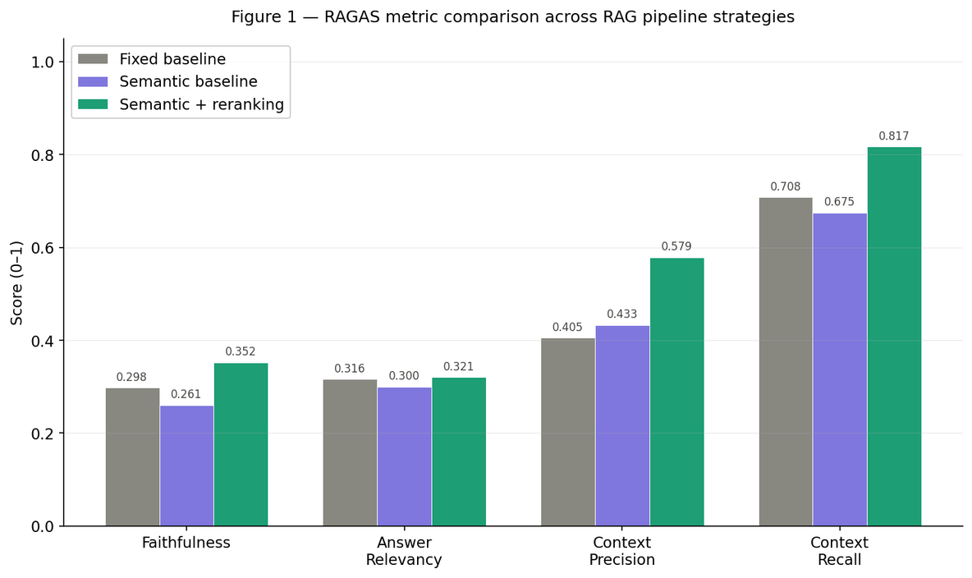
RAGAS RESULTS
Alternative pipeline
9
Context Precision: +43% Context Recall: +15% Tradeoff: 3× slower (1.5s -> 4.6s per query)
11

Slide 12
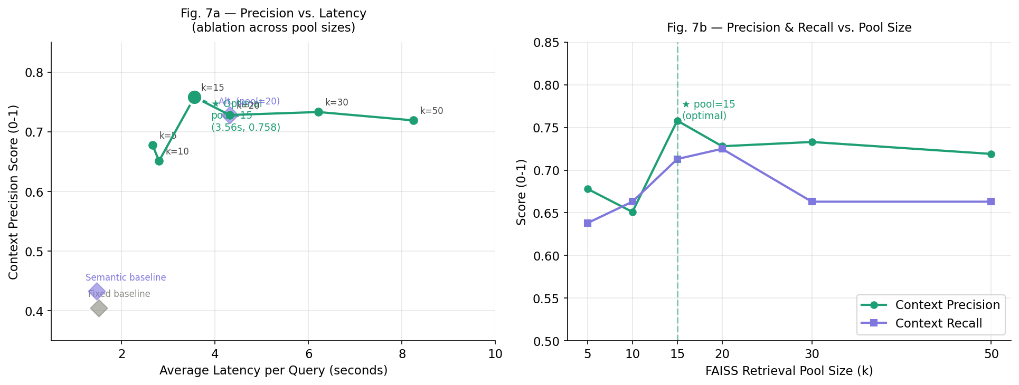
FAISS RETRIEVAL POOL SIZE ABLATION
Optimal: pool_size = 15
Precision: 0.758 | Recall: 0.713 | Latency: 3.56s
**Pool size ablated : empirical optimum is K=15
Default k=20 was suboptimal
k=15 is 21% faster with higher precision
Beyond k=15 latency climbs with no quality gain
16
\

Slide 13
RESULTS BY TIER
Tier 1
Tier 2
Tier 3
Basic retrieval works
Cross-section questions dropped to 0.22 with over-filtering -> Fixed by disabling metadata filter for synthesis questions -> 0.37
RAGAS penalizes correct refusals - custom metric needed
10
12

Slide 14
BENCHMARK STATISTICS
Dimension | Tier 1 | Tier 2 | Tier 3 | Total | Notes
Questions | 20 | 20 | 20 | 60 | Equal split per tier
Type | Single-section lookup | Cross-section reasoning | Adversarial / hallucination | 3 types | Escalating difficulty
Difficulty | Easy / Medium | Medium / Hard | Hard | … | T3 all hard
Correct answer | Factual answer from filing | Synthesized cross-section answer | Structured refusal | … | T3 always refuses
Failure tested | Retrieval accuracy | Cross-section synthesis | Hallucination / coverage gap | All 3 modes | Designed to isolate
Avg faithfulness | 0.60 (alt pipeline) | 0.37 (alt pipeline) | 0.08 (all pipelines) | 0.35 overall | T3 low by design
12
13

Slide 15
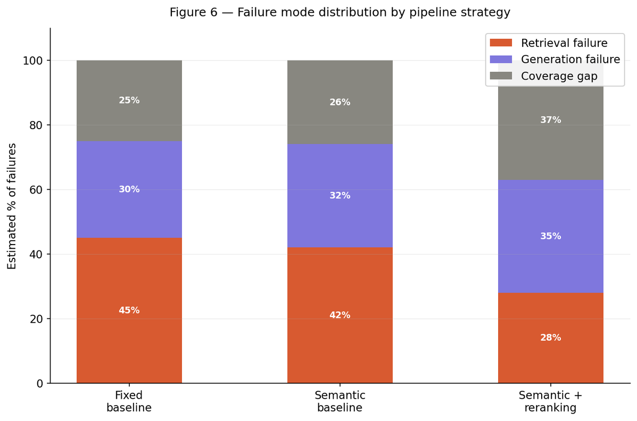
FAILURE ANALYSIS
Retrieval failure
Wrong chunks returned despite answer existing : 45% -> 28% with reranking
Generation failure
Right chunks, wrong answer LLM adds knowledge beyond context
12
Coverage gap
Answer not in any filing Target of low-confidence detector
14

Slide 16
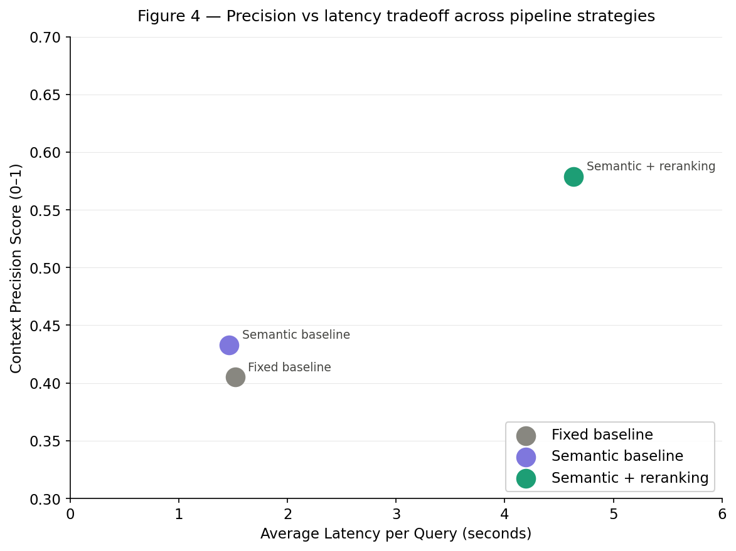
TRADEOFFS: PRECISON VS LATENCY
Fixed baseline: fast but imprecise
Semantic baseline: marginal gain
13
Alternative: best precision, highest cost
15

Slide 17
KEY FINDINGS
Semantic chunking: 24% fewer chunks, same or better scores
Cross-encoder reranking: +43% context precision
Metadata filtering: helps Tier 1, hurts Tier 2 without cross-section detection
Coverage gap is the dominant failure mode in adversarial queries
14
16

Slide 18
NEXT STEPS
Full corpus embedding on Beocat : 6,500+ filings, GPU acceleration
Low-confidence detector calibration : domain-specific thresholds
Custom adversarial metric : RAGAS penalizes correct refusals
15
17

